Slide 1
Wi-Fi:
Starspace 46 guest
Password:
Techlahoma

Slide 2
Free Code Camp OKC
fccokc.com
linkedin.com/groups/12086660
meetup.com/FreeCodeCampOKC
twitter.com/FreeCodeCampOKC

Slide 3
Thanks for joining us today! We're here thanks to volunteers, speakers, and Techlahoma.

Slide 4
What is Techlahoma?
non-profit volunteer-run organization
hosts 33 groups and 2 conferences
sponsors free local events
supports the grassroots tech community of Oklahoma

Slide 5
Techlahoma.org
meetup.com/pro/Techlahoma
twitter.com/Techlahoma
donate.techlahoma.org/membership

Slide 6
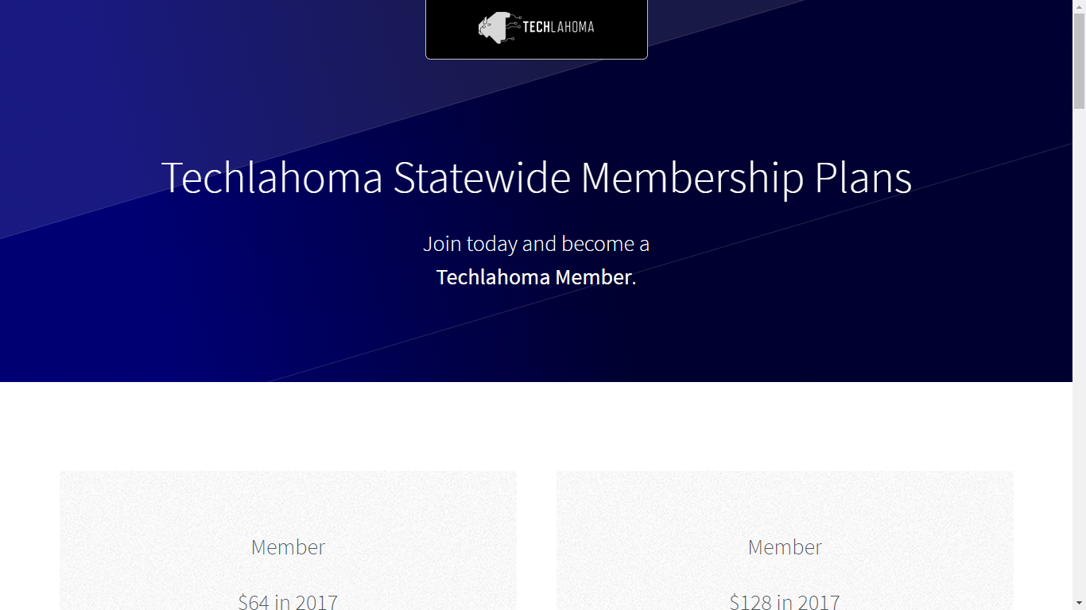
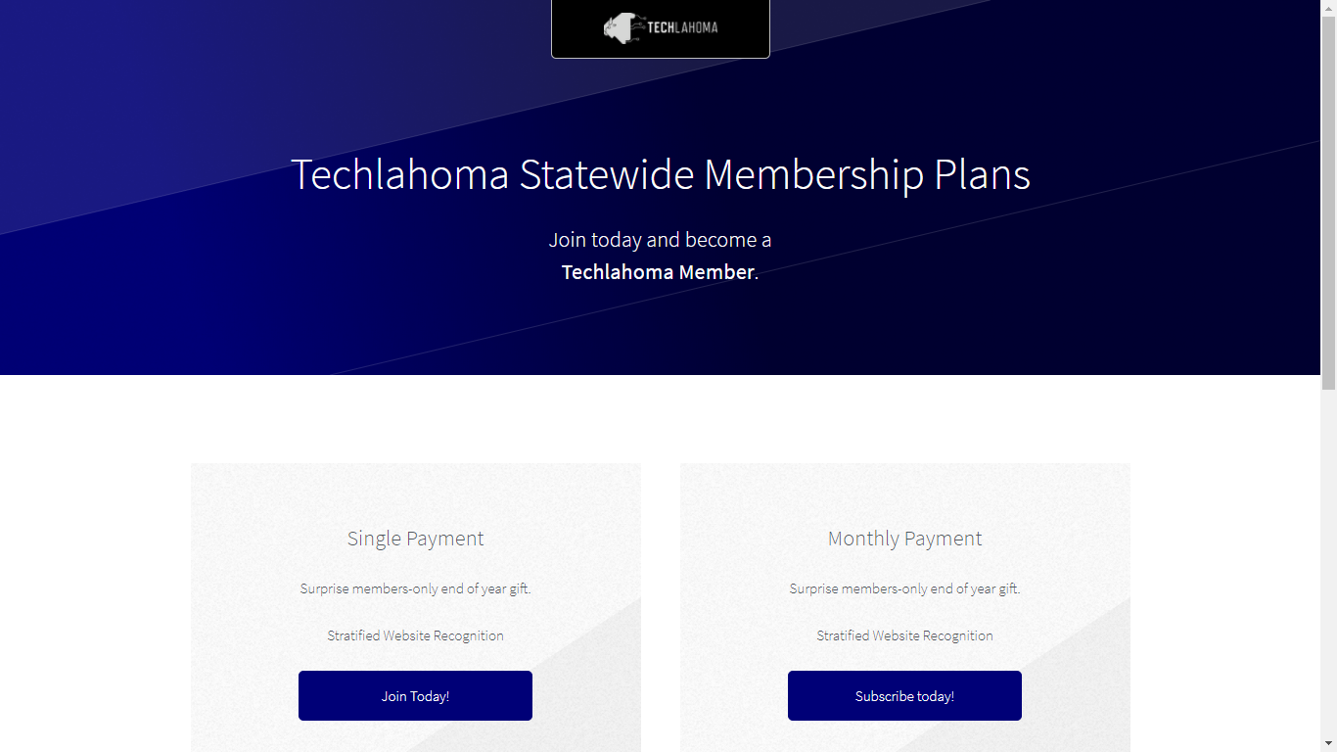

Slide 7
StarSpace46.com
starspace46.com/calendar-1
twitter.com/StarSpace46
Community membership $40/month

Slide 8
Twitch.tv/Techlahoma
Live streaming at StarSpace46
Subscribe with Amazon Prime
Techlahoma gets a small donation from Amazon

Slide 9
Slack
fccokc.com/slack
Channels for #freecodecamp, #jobs, and over 150 other topics

Slide 10
OKC#
Monday 1/8
11:30 - 12:30
Lightning Talks
meetup.com/okc-sharp

Slide 11
OKC Java
Tuesday 1/9
11:30 - 12:30
Google Web Toolkit
meetup.com/okcjug

Slide 12
OKC Python
Wednesday 1/10
11:30 - 12:30
Geospatial Data in MySQL with Python
meetup.com/okcpython

Slide 13
OKC Ruby
Thursday 1/11
11:30 - 12:30
The Odin Project: The pros and cons of a meta-tutorial (Joe Lee)
meetup.com/okc-ruby

Slide 14
OKC Open Source Hardware
Saturday 1/13
2:00 - 4:00 pm
Meet Liger! A FOSS light switch for home automation/security
meetup.com/okc-osh

Slide 15
Free Code Camp OKC
Sunday 1/14
2:00 - 3:00 pm
Intro to APIs
meetup.com/freecodecampokc

